Slide 1
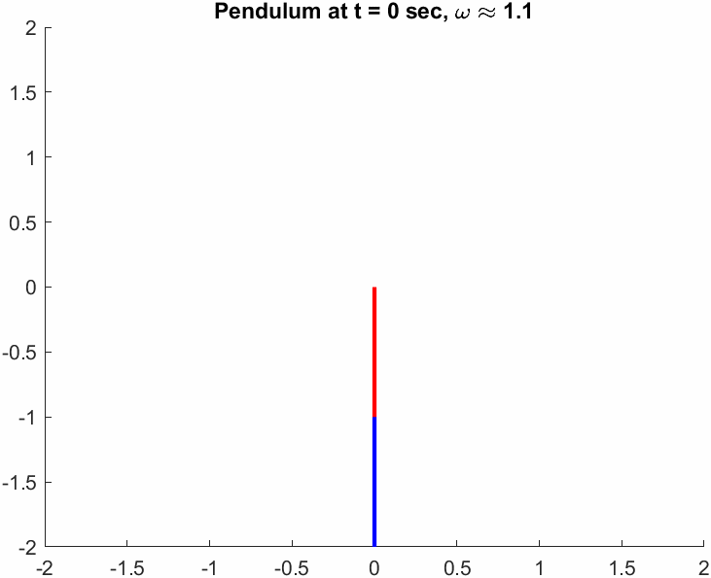
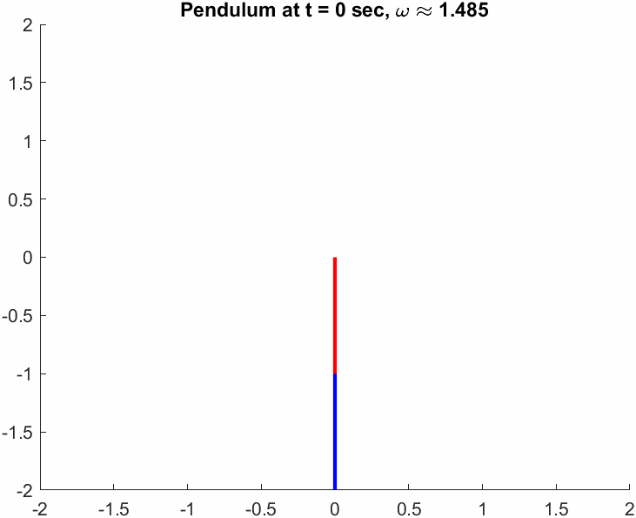
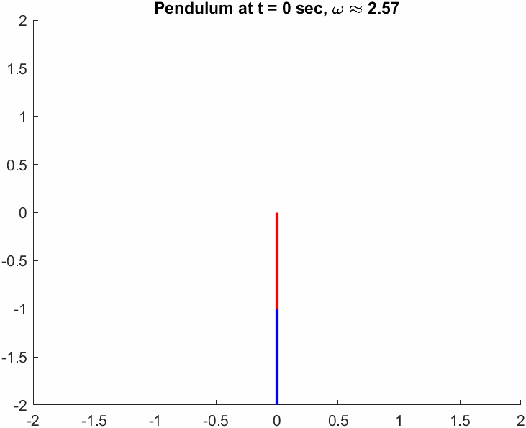
Initial Plots of System Stability – Animations at Resonance
(1)
(2)
(3)
Both members perfectly in phase
Antiresonance
Both members perfectly out of phase

